Slide 1


Raihan Insan Habibi
Wednesday, January 5, 2022

Slide 2

Outline
Executive Summary
Introduction
Methodology
Results
Conclusion
Appendix

Slide 3
Executive Summary
-summary results and methodology

Slide 4
Introduction
Project background and context
Problems you want to find answers

Slide 5


Slide 6
Methodology
Executive Summary
Data collection methodology:
Describe how data was collected
Perform data wrangling
Describe how data was processed
Perform exploratory data analysis (EDA) using visualization and SQL
Perform interactive visual analytics using Folium and Plotly Dash
Perform predictive analysis using classification models
How to build, tune, evaluate classification models

Slide 7
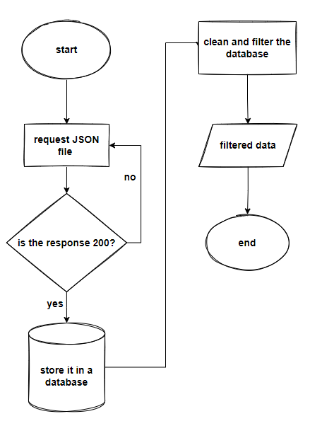
Data Collection
Describe how data sets were collected.
You need to present your data collection process use key phrases and flowcharts

Slide 8
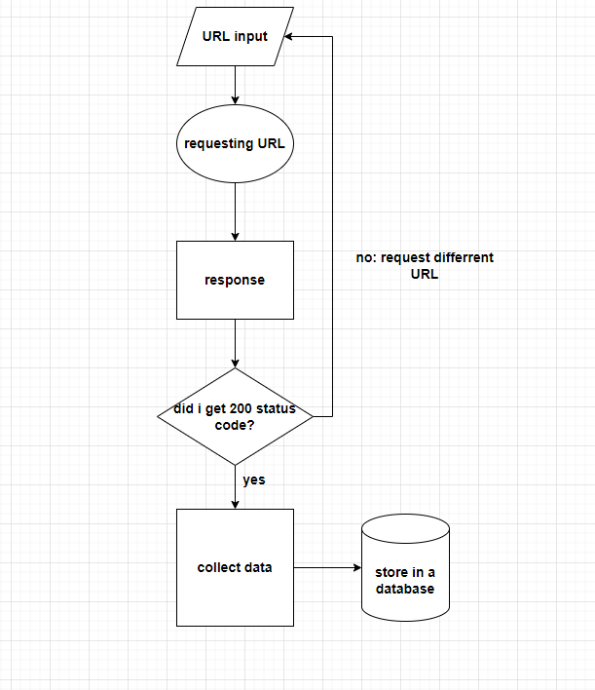
Data Collection – SpaceX API
reference:
https://github.com/RaihanTeachesCodes/IBM_course_10-/blob/master/data%20collection.ipynb
The SpaceX API is first input in a string, we take the response by requesting it using the Request Module. If the response is a success we can collect the data in the form of a JSON file then filter out the data we need. We can then form this data into a database.

Slide 9
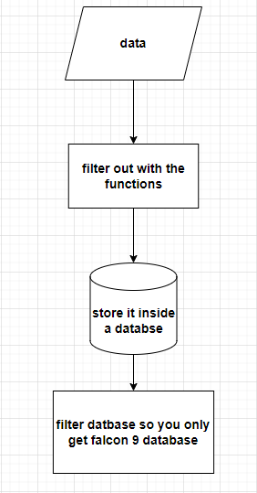
Data Collection - Scraping
Reference:
https://github.com/RaihanTeachesCodes/IBM_course_10-/blob/master/data%20collection.ipynb
Using the data we collected we filter it out using the getboosterversion( ), getlaunchsite( ), getpayloaddata( ), and getcoredata( ). Then store it in the form of a database using the pd.DataFrame method.

Slide 10
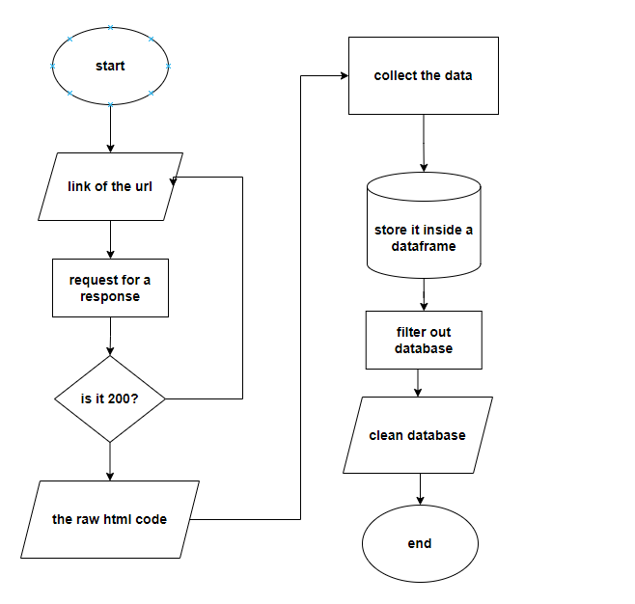
Data Wrangling
Reference:
https://github.com/RaihanTeachesCodes/IBM_course_10-/blob/master/data%20wrangling.ipynb
The data was processed by using a for loop to automatically scrape the html. And store it inside a database.

Slide 11
EDA with Data Visualization
Reference:
https://github.com/RaihanTeachesCodes/IBM_course_10/blob/master/EDA%20with%20Data%20Visualization.ipynb
To visualize the difference of relationship between the 2 data I used a cat plot because it was much easier to tell the difference. For separating the class I used a bar chart because it was easier to understand. To visualize the launch success yearly trend I used a line chart because I can see the trend much easier and clear.

Slide 12
EDA with SQL
Reference:
https://github.com/RaihanTeachesCodes/IBM_course_10-/blob/master/eda%20sql.ipynb
We take out the database by first connecting to my credentials.
Filter out the data using that database

Slide 13
Build an Interactive Map with Folium
Reference:
https://github.com/RaihanTeachesCodes/IBM_course_10-final-project/blob/master/launch_site_locations.ipynb
I have created circles because I want to show the accessible landing site in a specific radius. The markers are used to point out the location of the landing site. And the line is used to represent the distance between a launch site to its proximities. I believe these object creates a beautiful visualization to the folium map with clear understanding about the data.

Slide 14
Build a Dashboard with Plotly Dash
Reference: https://github.com/RaihanTeachesCodes/IBM_course_10-/blob/master/spacex_dash_app.py
I have added the pie charts because its easier to classify each variable in different amount. Dropdown is there to give different data and with the slider changing the results of the graphs. And lastly the scatter chart shows the relationship between two variables.

Slide 15
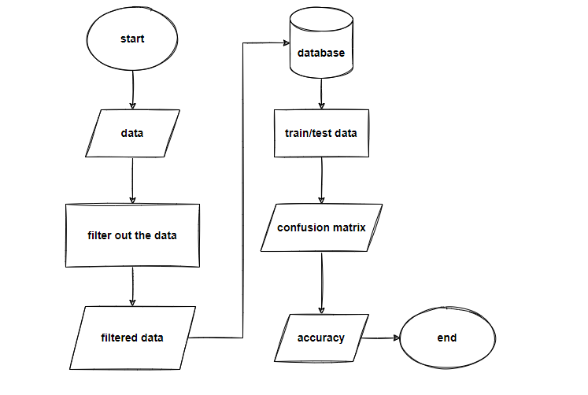
Predictive Analysis (Classification)
Summarize how you built, evaluated, improved, and found the best performing classification model
Reference:
https://github.com/RaihanTeachesCodes/IBM_course_10-/blob/master/Machine%20Learning%20Prediction.ipynb
After I took the database, I cleaned and filtered the data we need. Then I train and tested the data to create a confusion matrix module. I then output all types of accuracy score and give out the highest accuracy which was the KNN score

Slide 16
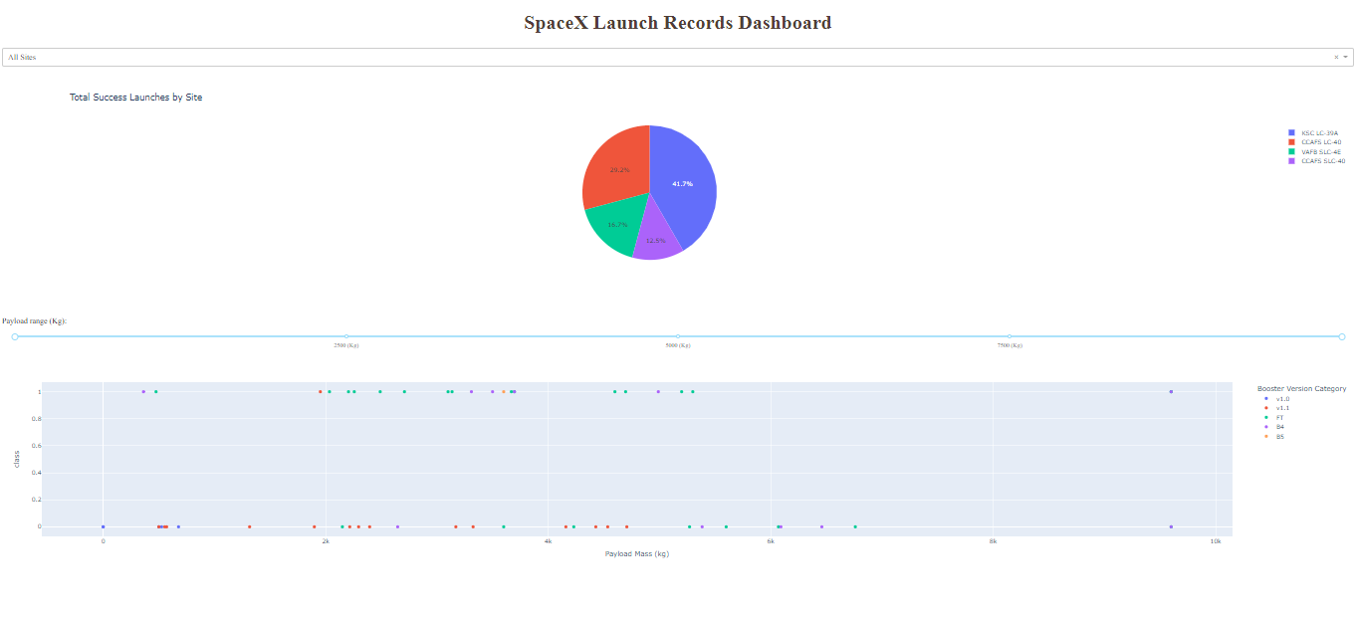
Results
Exploratory data analysis results
Predictive analysis results

Slide 17
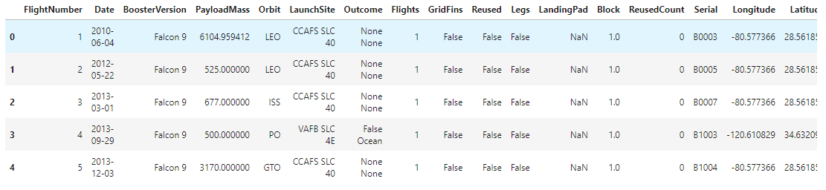
Results
Exploratory data analysis results
Predictive analysis results

Slide 18
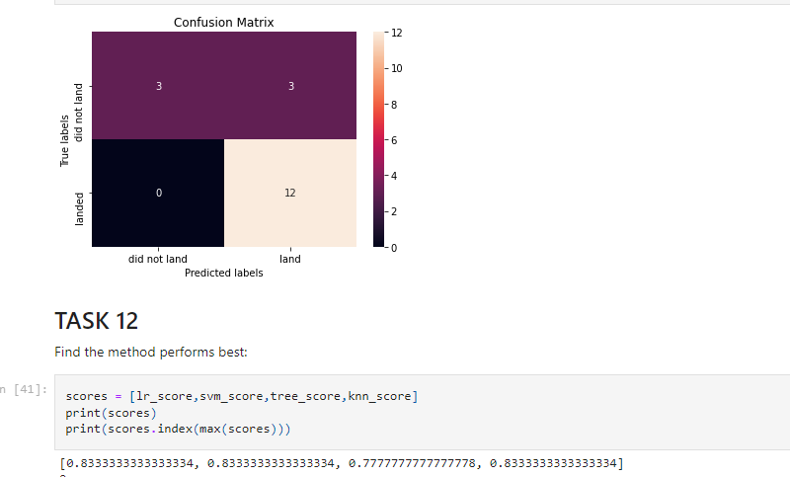
Results
Exploratory data analysis results
Predictive analysis results

Slide 19


Slide 20
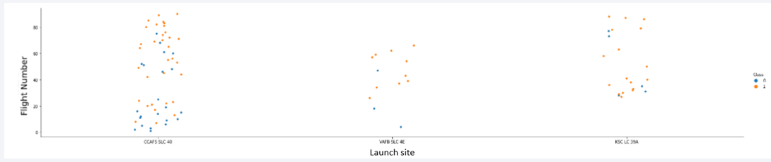
Flight Number vs. Launch Site
As you can see from this scatter plot, most launch site is in ‘CCAF5 SLC 4E’ , and least number is in launch site ‘VAFB SLC 4E’

Slide 21
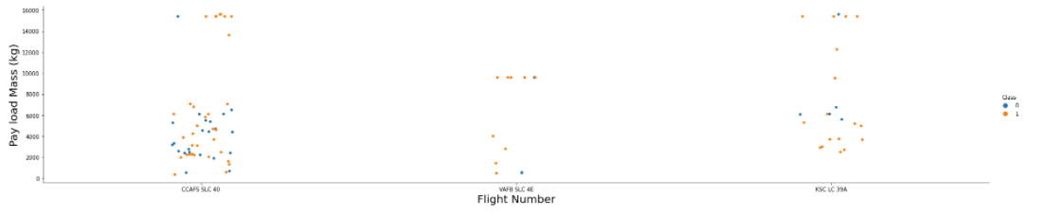
Payload vs. Launch Site
Show a scatter plot of Payload vs. Launch Site

Slide 22
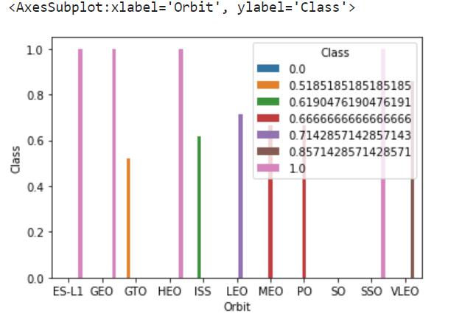
Success Rate vs. Orbit Type
Show the screenshot of the scatter plot with explanations

Slide 23
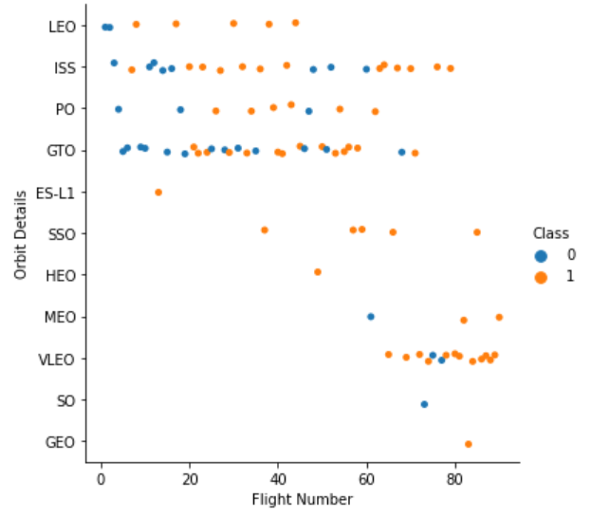
Flight Number vs. Orbit Type
Show the screenshot of the scatter plot with explanations

Slide 24
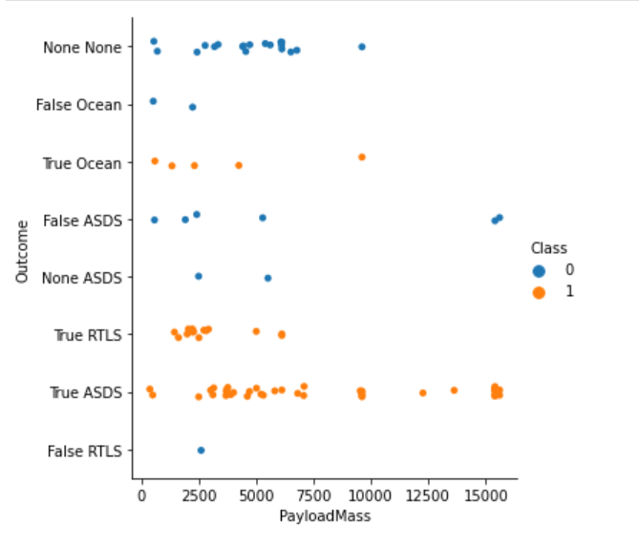
Payload vs. Orbit Type
Show the screenshot of the scatter plot with explanations

Slide 25
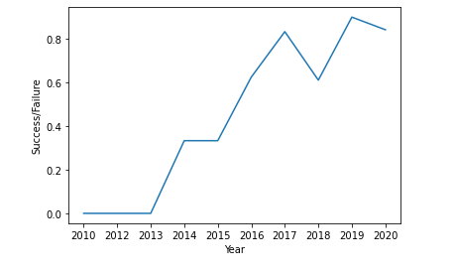
Launch Success Yearly Trend
Show the screenshot of the scatter plot with explanations

Slide 26
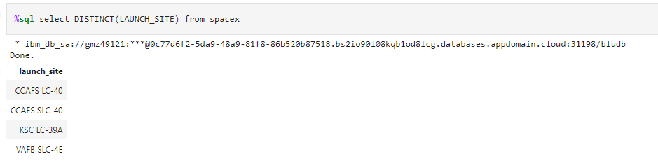
All Launch Site Names
Find the names of the unique launch sites
Present your query result with a short explanation here

Slide 27
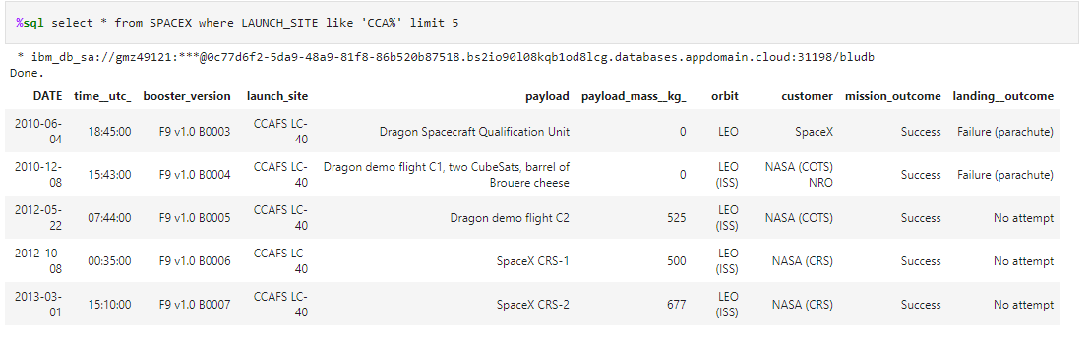
Launch Site Names Begin with 'CCA'
Find 5 records where launch sites begin with `CCA`
Present your query result with a short explanation here

Slide 28
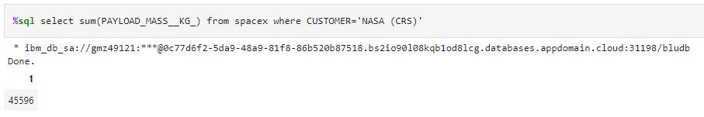
Total Payload Mass
Calculate the total payload carried by boosters from NASA
Present your query result with a short explanation here

Slide 29
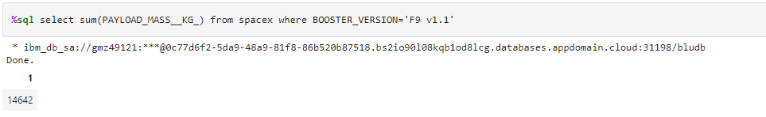
Average Payload Mass by F9 v1.1
Calculate the average payload mass carried by booster version F9 v1.1
Present your query result with a short explanation here

Slide 30
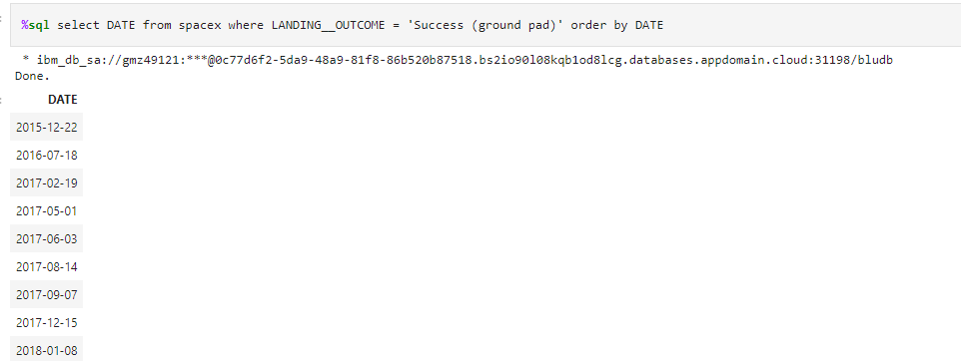
First Successful Ground Landing Date
Find the dates of the first successful landing outcome on ground pad
Present your query result with a short explanation here

Slide 31
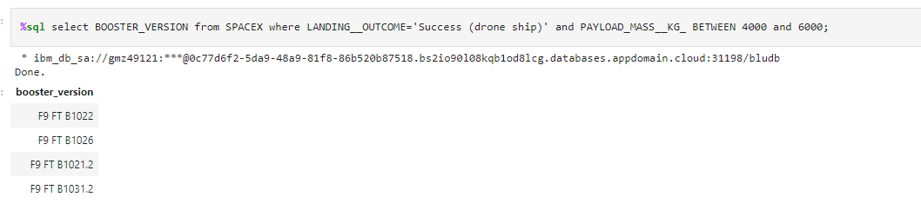
Successful Drone Ship Landing with Payload between 4000 and 6000
List the names of boosters which have successfully landed on drone ship and had payload mass greater than 4000 but less than 6000
Present your query result with a short explanation here

Slide 32
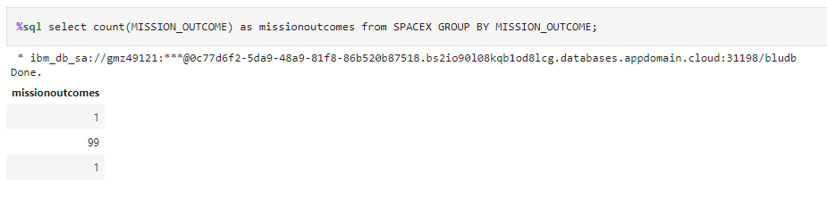
Total Number of Successful and Failure Mission Outcomes
Calculate the total number of successful and failure mission outcomes
Present your query result with a short explanation here

Slide 33
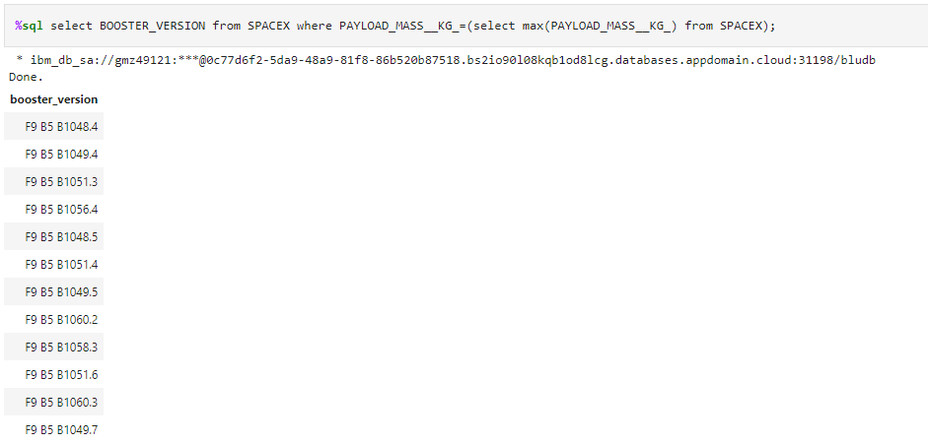
Boosters Carried Maximum Payload
List the names of the booster which have carried the maximum payload mass
Present your query result with a short explanation here

Slide 34
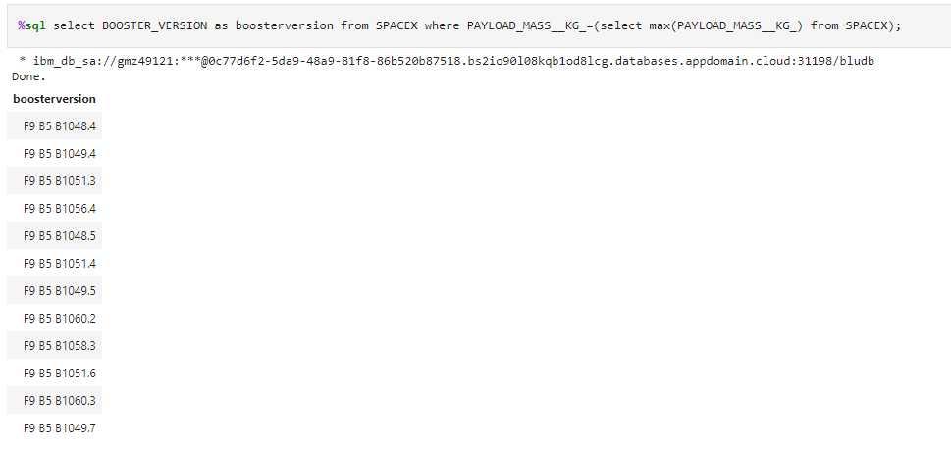
2015 Launch Records
List the failed landing_outcomes in drone ship, their booster versions, and launch site names for in year 2015
Present your query result with a short explanation here

Slide 35
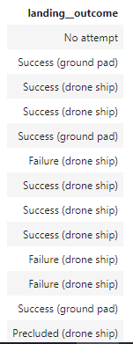
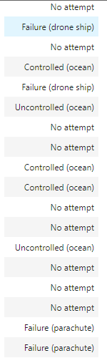
Rank Landing Outcomes Between 2010-06-04 and 2017-03-20
Present your query result with a short explanation here

Slide 36


Slide 37
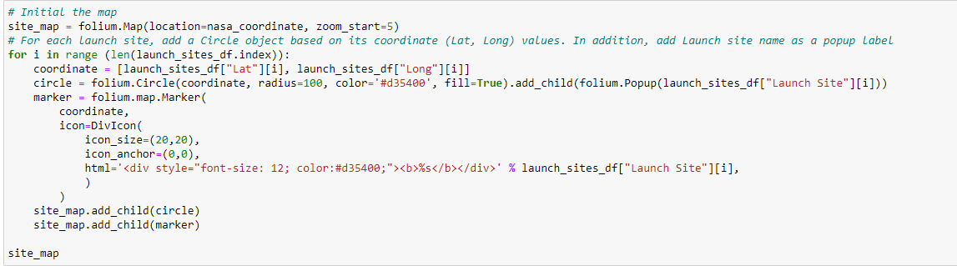
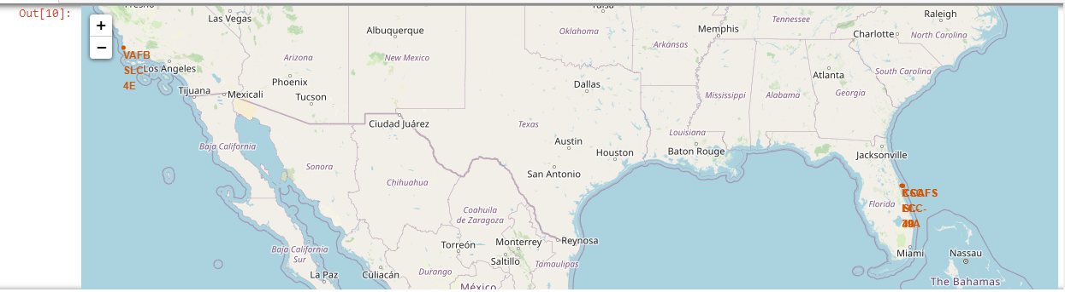
all launch sites on a map
Explain the important elements and findings on the screenshot

Slide 38
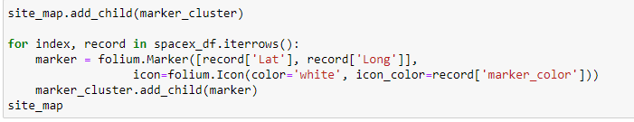
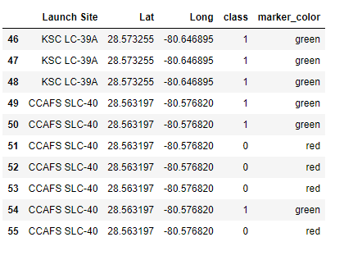
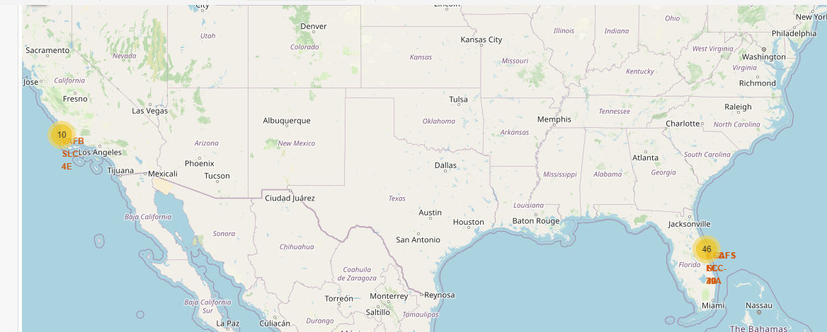
Marking the success/failed launches for each site on the map
Explain the important elements and findings on the screenshot

Slide 39
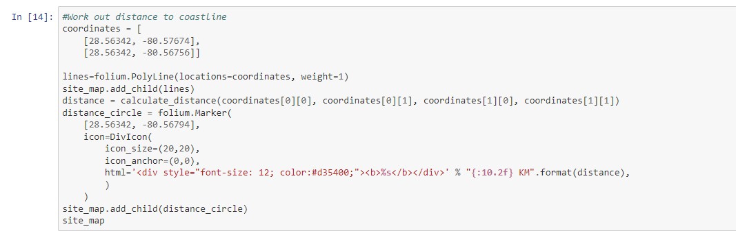
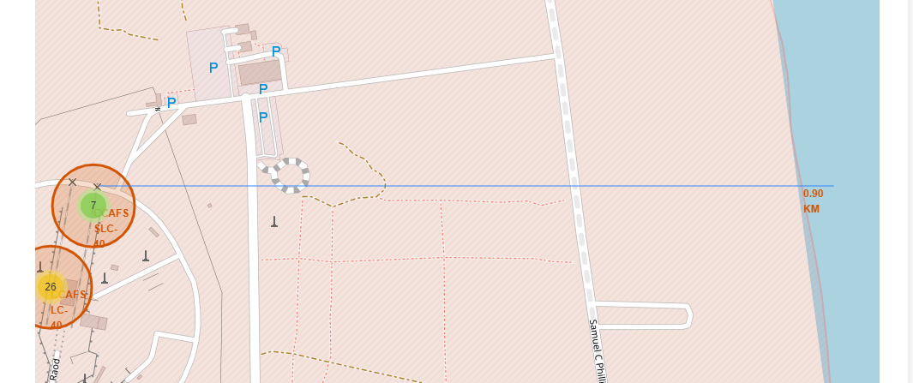
Calculating the distances between a launch site to its proximities
Explain the important elements and findings on the screenshot

Slide 40


Slide 41
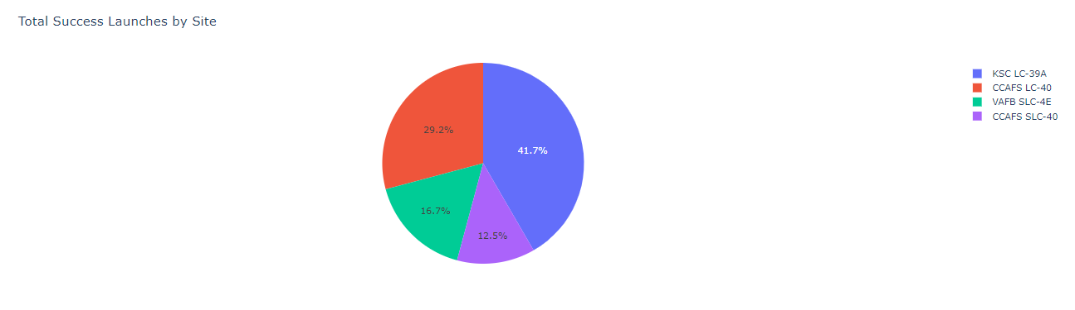
screenshot of launch success count for all sites, in a piechart
Explain the important elements and findings on the screenshot

Slide 42
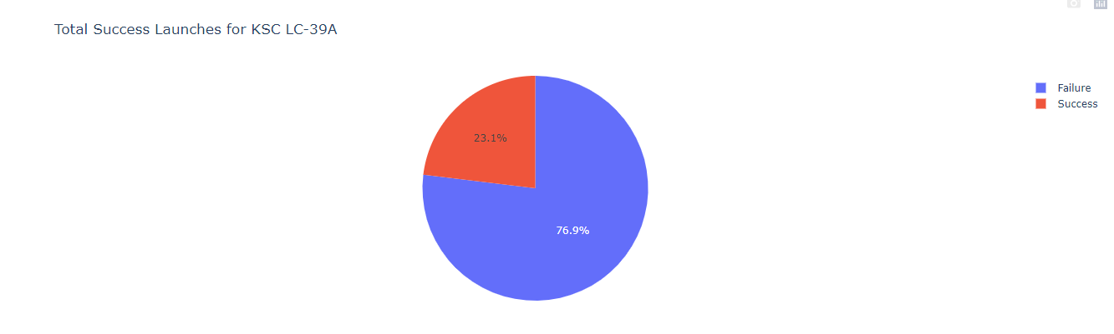
pie chart for the launch site with highest launch success ratio
Explain the important elements and findings on the screenshot

Slide 43
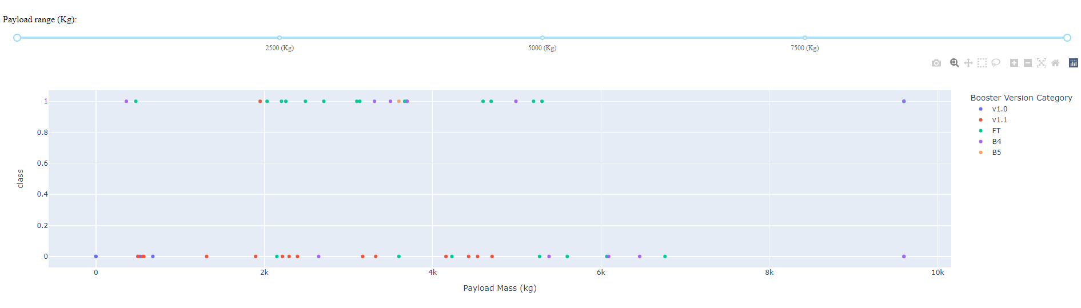
Payload vs. Launch Outcome scatter plot for all sites

Slide 44
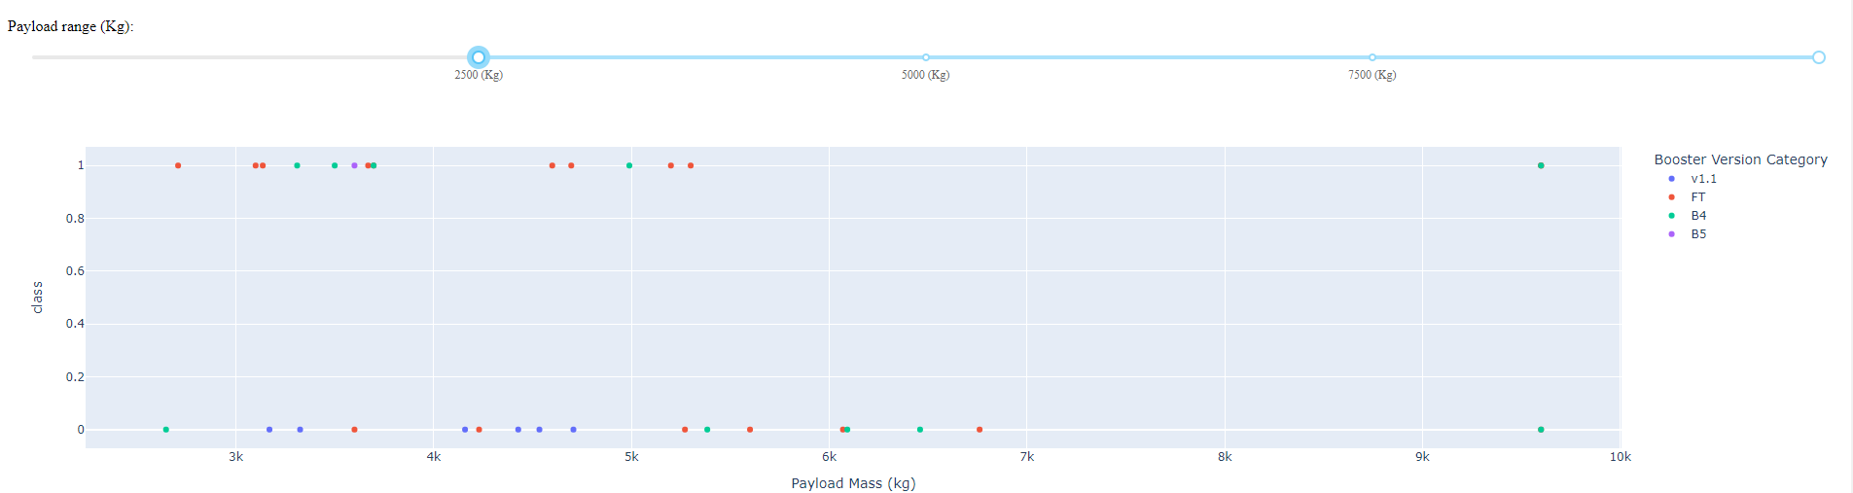
Payload vs. Launch Outcome scatter plot for all sites

Slide 45
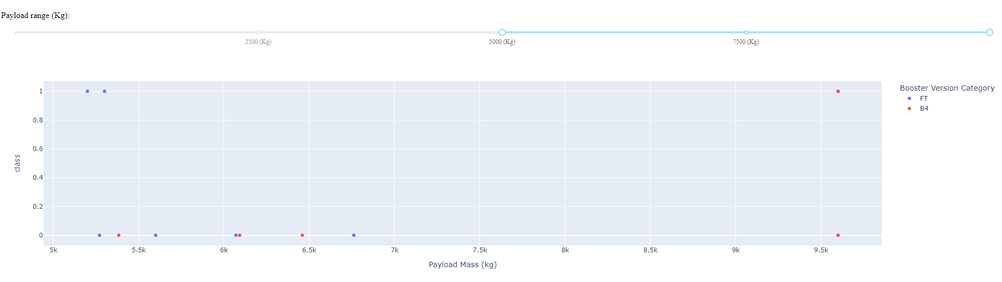
Payload vs. Launch Outcome scatter plot for all sites

Slide 46
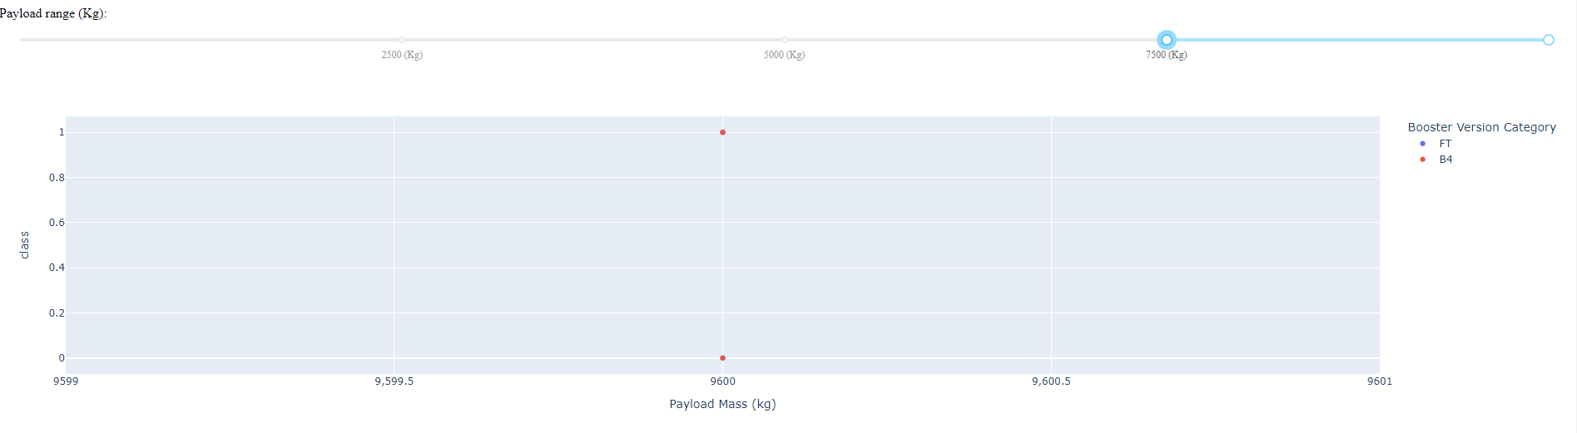
Payload vs. Launch Outcome scatter plot for all sites

Slide 47


Slide 48
Classification Accuracy
Visualize the built model accuracy for all built classification models, in a bar chart
Find which model has the highest classification accuracy

Slide 49
Confusion Matrix
Show the confusion matrix of the best performing model with an explanation

Slide 50
Conclusions
Point 1
Point 2
Point 3
Point 4
…

Slide 51
Appendix
Include any relevant assets like Python code snippets, SQL queries, charts, Notebook outputs, or data sets that you may have created during this project

Slide 52


